Slide 1
ENNOVE ANALYTICS
Bright TV
Viewership Project
Exploring entertainment, insights & experience —
growing the subscriber base through data.
PRESENTED BY
Innocent Mphahlele
Data Analyst · Ennove Analytics

Slide 2
BRIGHT TV · VIEWERSHIP PROJECT
02 / 09
Agenda
What we'll cover in the next 15 minutes
01
Introduction
02
Objectives
CEO brief & business question
What insights we set out to deliver
03
Project Architecture
04
Process & Timeline
Tooling & workflow
Process map and Gantt plan
05
Data Pipeline
06
Key Insights
Databricks ingestion & SQL prep
Demographics, geography, channels, time
07
Dashboard
08
Recommendations
Excel viewership dashboard
Initiatives to grow the base
Ennove Analytics · Innocent Mphahlele

Slide 3
BRIGHT TV · VIEWERSHIP PROJECT
03 / 09
Introduction
The CEO has a clear ask — and a clear deadline
“
INSIGHTS WE MUST DELIVER
01
User & usage trends
Bright TV's CEO wants to grow the subscription base this financial year. He has approached the analytics team to provide insights that will help CVM (Customer Value Management) hit the target.
Who watches, when, and how much.
02
Drivers of consumption
What factors influence viewing behaviour.
03
Content for low days
What to schedule on weak-demand days.
04
Growth initiatives
— CEO, Bright TV
How to expand the active user base.
Ennove Analytics · Innocent Mphahlele

Slide 4
BRIGHT TV · VIEWERSHIP PROJECT
04 / 09
Project Architecture
From a CEO question to a tested, reproducible analytical pipeline
PROBLEM STATEMENT
TOOL STACK
Viewership and revenue are declining. Leadership needs a clear, evidence-based explanation — and a path to reverse the trend.
MIRO
Brainstorming & mind-mapping
Canva
Process maps & visuals
OUR APPROACH
Microsoft Excel
Dashboarding & pivot analysis
Brainstorm the question with stakeholders, then plan, ingest, clean, model, and visualise — closing the loop with executive recommendations.
Databricks (SQL)
Data ingestion & manipulation
PowerPoint
Executive storytelling
Ennove Analytics · Innocent Mphahlele

Slide 5
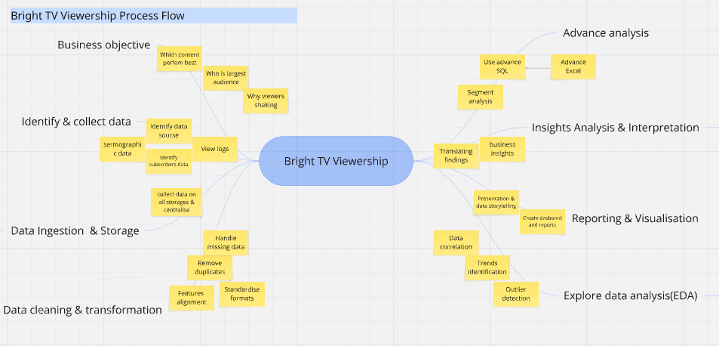
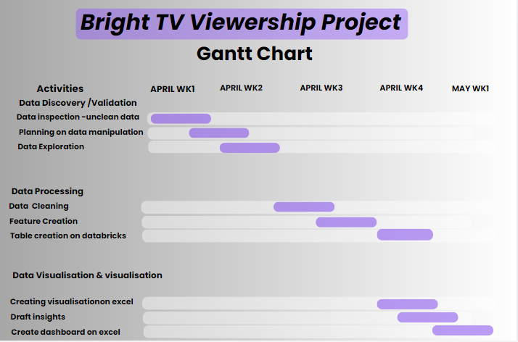
BRIGHT TV · VIEWERSHIP PROJECT
05 / 09
Process & Timeline
A 5-week sprint from raw data to executive readout
PROCESS FLOW (CANVA)
PROJECT PLAN (GANTT)
Ennove Analytics · Innocent Mphahlele

Slide 6
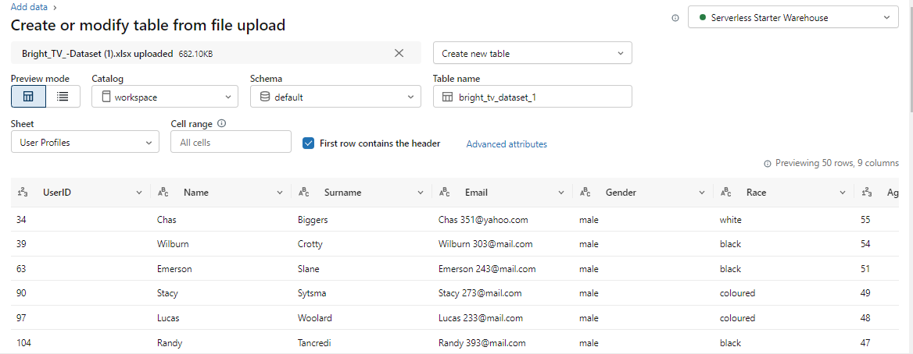
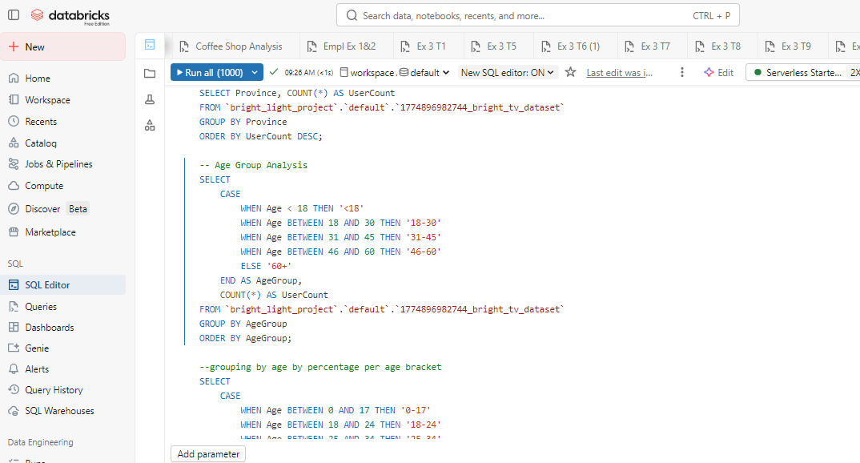
BRIGHT TV · VIEWERSHIP PROJECT
06 / 09
Data Pipeline
Ingested in Databricks, transformed with SQL, visualised in Excel
01
02
03
04
INGEST
›
MODEL
›
ANALYSE
›
VISUALISE
Upload User Profiles + Viewership logs to Databricks workspace.
Join, deduplicate, derive age groups, time slots & channel categories.
Run SQL queries for province, gender, race, age, channel & hour cuts.
Export to Excel and build a 2-page interactive dashboard.
DATABRICKS WORKSPACE
SQL TRANSFORMATIONS
Ennove Analytics · Innocent Mphahlele

Slide 7
BRIGHT TV · VIEWERSHIP PROJECT
07 / 09
Key Insights
Four findings shaping the growth strategy
37%
8,761
43%
4,455
of viewers in Gauteng
male viewers (top segment)
share from Black audience
adults — largest age bucket
GEOGRAPHY
DEMOGRAPHICS
Gauteng dominates with 37% of viewership, followed by Western Cape (18%) and KwaZulu-Natal (10%).
Adults (4,455) and young adults (4,004) drive the platform. Senior viewers (70) are a clear gap.
TIME OF DAY
TOP CHANNELS
Viewing peaks 7–10 AM and again at night. Afternoons are the weakest slot.
SuperSport Live Events and ICC Cricket World Cup lead — sports content is the engine.
Ennove Analytics · Innocent Mphahlele

Slide 8
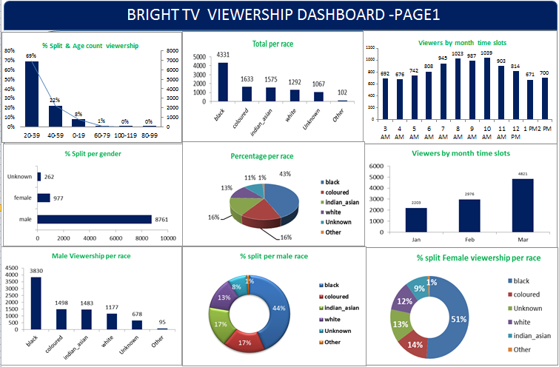
BRIGHT TV · VIEWERSHIP PROJECT
08 / 09
Viewership Dashboard
Excel dashboard — demographics, geography & channel performance
AT A GLANCE
Peak hour
10 AM (1,039 viewers)
Strongest month
March — 4,821 viewers
Top race segment
Black — 43%
Gender split
Male 8,761 · Female 977
Unknowns
262 gender, 1,067 race ⚠
Ennove Analytics · Innocent Mphahlele

Slide 9
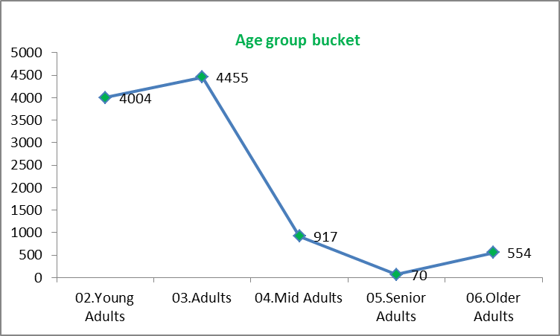
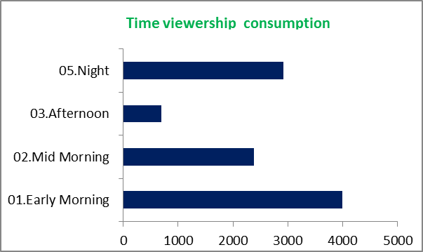
BRIGHT TV · VIEWERSHIP PROJECT
08B / 09
Viewership Dashboard — Page 2
Audience age profile & time-of-day consumption
AGE GROUP BUCKET
TIME-OF-DAY CONSUMPTION
Adults & young adults dominate viewing
Early morning is the strongest slot
4,455
Adults — largest segment
4,004
Young Adults — close second
4,000+
Early-morning viewers
700
Afternoon — weakest slot ⚠
Ennove Analytics · Innocent Mphahlele

Slide 10
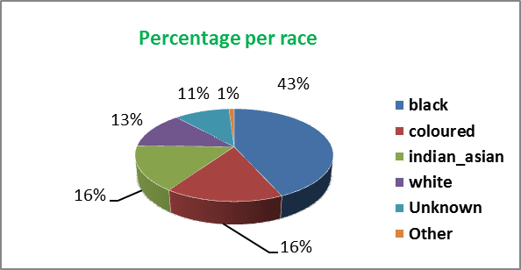
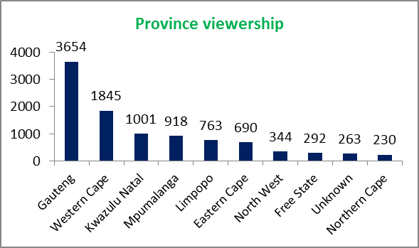
BRIGHT TV · VIEWERSHIP PROJECT
08C / 11
Viewership Dashboard — Page 3
Race composition & provincial reach
RACE — % SHARE
PROVINCIAL VIEWERSHIP
Black audience leads at 43%
Gauteng dwarfs every other province
43%
Black viewers — top segment
3,654
Gauteng viewers (rank 1)
1,067
Unknown race ⚠ data gap
230
Northern Cape — lowest reach
Ennove Analytics · Innocent Mphahlele

Slide 11
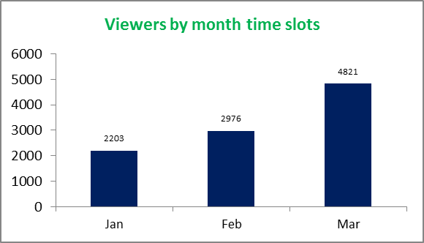
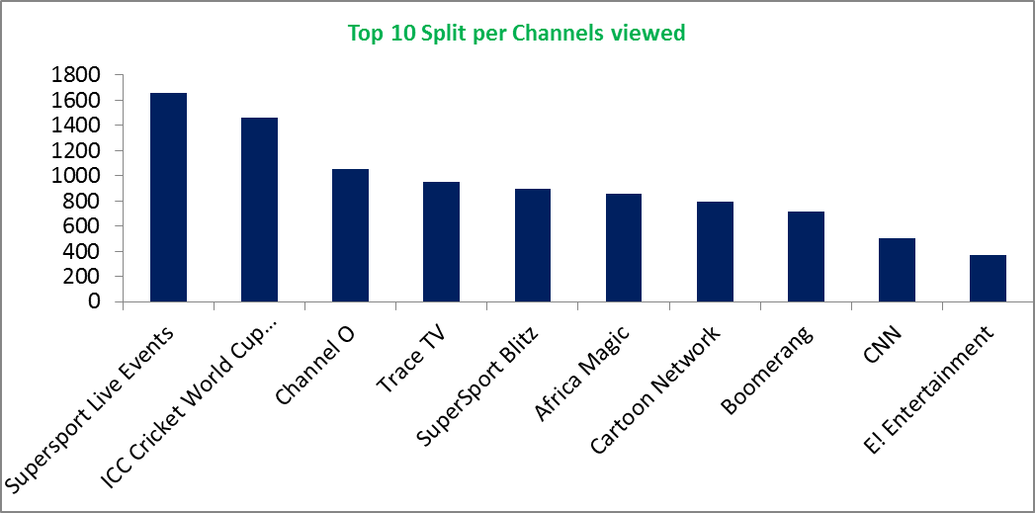
BRIGHT TV · VIEWERSHIP PROJECT
08D / 11
Viewership Dashboard — Page 4
Monthly momentum & top-performing channels
VIEWERS BY MONTH
TOP 10 CHANNELS
March surge — 4,821 viewers
Sport carries the platform
+62%
Jan→Mar viewer growth
1,650
SuperSport Live — #1 channel
1,450
ICC Cricket World Cup — #2
370
E! Entertainment — bottom of top 10
Ennove Analytics · Innocent Mphahlele

Slide 12
BRIGHT TV · VIEWERSHIP PROJECT
09 / 09
Recommendations & Next Steps
Six initiatives to grow Bright TV's subscriber base
1
Automate KPI tracking
2
Clean profile data
3
Investigate weak platforms
Continuously monitor viewer performance and behaviour in a live dashboard.
Send follow-up prompts to viewers with incomplete profiles to remove 'Unknown' segments.
Add in-app feedback forms on under-performing channels to learn why.
4
Launch WhatsApp service
5
Targeted offers
6
Schedule for off-peak
Customer rating channel for service quality and content satisfaction.
Discounts or free preview windows for low-engagement subscribers.
Programme stronger content into afternoons — the weakest viewing slot.
Thank you · Questions welcome
Innocent Mphahlele · Ennove Analytics
Ennove Analytics · Innocent Mphahlele

